Slide 1


Meeting 2

Slide 2
Meeting 2
Embedded Systems
IEEE - CSULB Branch

Slide 3
Agenda
FREE Review
Integrated Circuit (IC) Chips
Microprocessors
Microcontrollers (MCUs)
Development/Breakout Boards
Embedded Systems
Demo: Blinky and terminal print
Supplemental Demo: Traffic Light

Slide 4
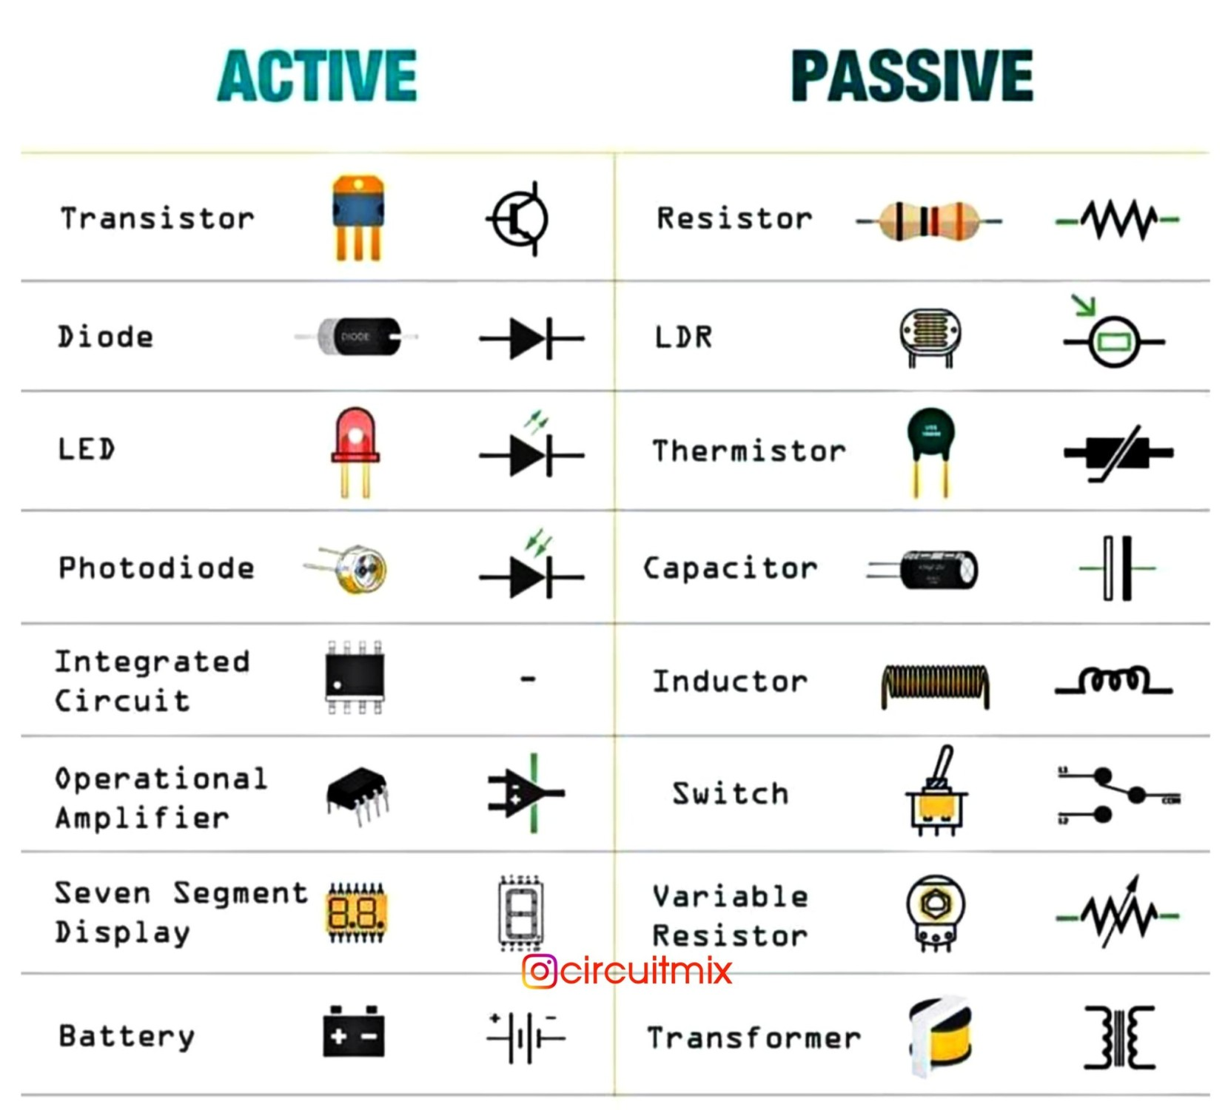
FREE Review (Components)
Active components (i.e. transistors, operational amplifiers, and integrated circuits) do require power in some way to make them work.
Passive components (i.e. resistors, capacitors) do not require any form of electrical power to operate.

Slide 5
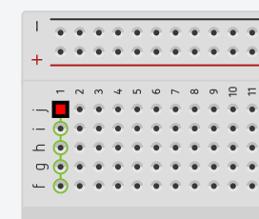
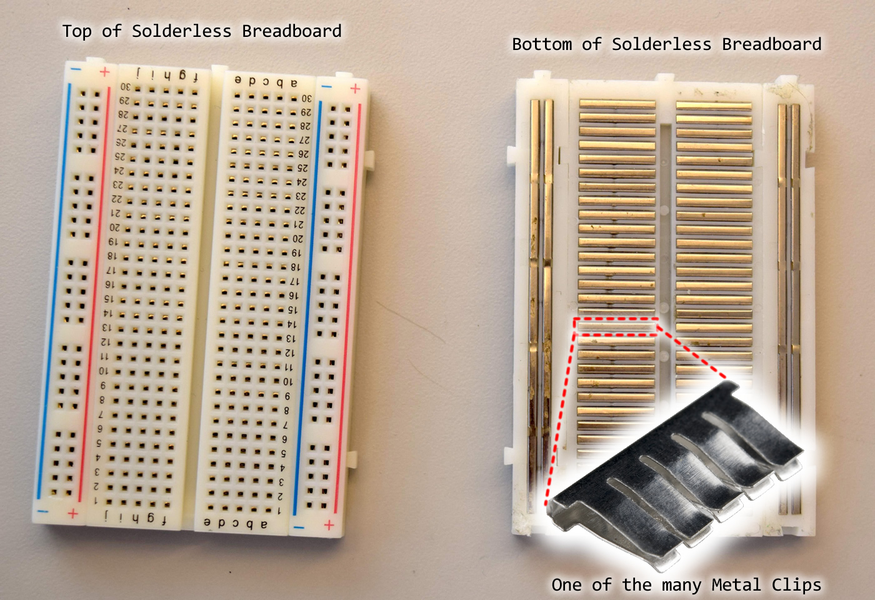
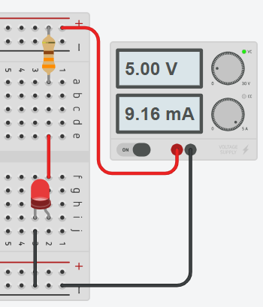
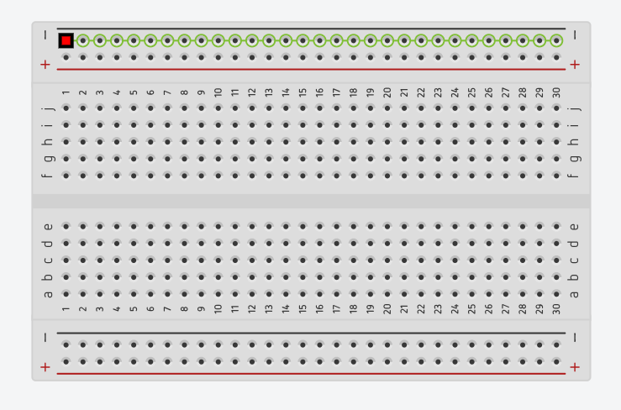
FREE Review (Breadboard)
(+) or (-) marked rails are connected in a row.
Pinholes between buses connect in a column.
“Power up” and “GND faced down”
Notes:
Will complete this by sunday - Robert

Slide 6
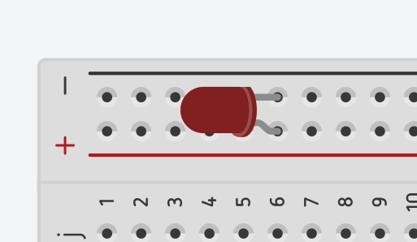
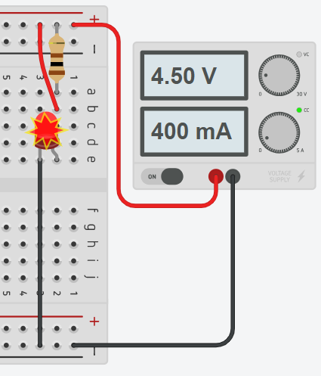
FREE Review (Breadboard)
Short circuit:
Most of the current takes the path with the least resistance and flows directly through component.
Can cause burnouts or fires.
Space out your circuit on a breadboard. Isolate your voltage supply and ground connections and use insulated wires.
Notes:
Will complete this by sunday - Robert

Slide 7
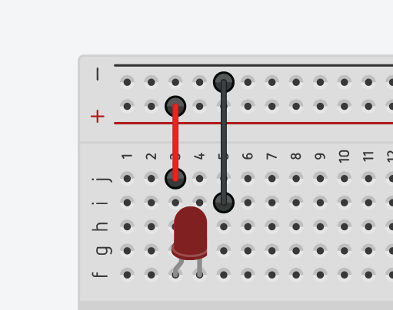
FREE Review (Breadboard)
Open circuit:
Connection between high and low potential is severed, preventing current from flowing through the circuit. Results in no current or unusual signal readings.
Usually caused by misaligned pins, loose wiring connections, frayed wires.
Test your wires or components with a DMM “continuity test”.

Slide 8

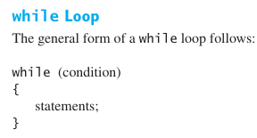
FREE Review (Programming with C) Reference: Engineering Problem Solving with C
Application:
Data control structures (sequence, selection, repetition) outline how software commands hardware.
While loop:
“An infinite loop is generated if the condition in a while loop is always true”.
Comments:
Single line comments: Compound statement comments
// comment /* comment1
comment2
comment3 */
Notes:
Will complete this by sunday - Robert

Slide 9
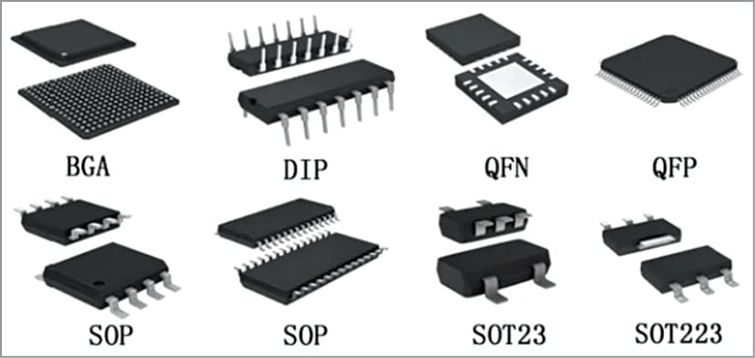
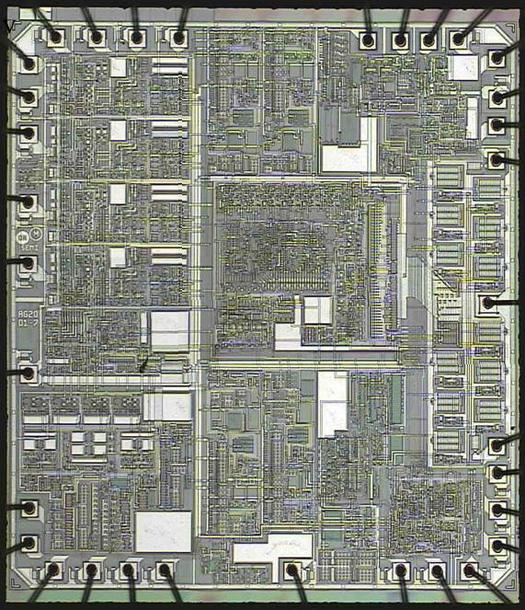
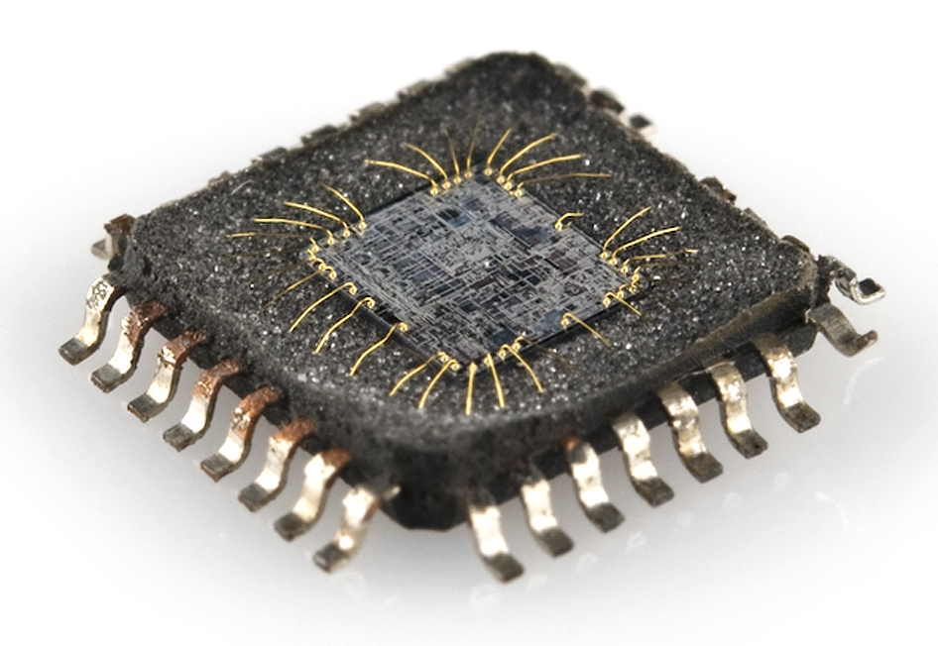
Integrated Circuit (IC) Chips
IC (Integrated Circuit) Chips are small electronic circuits consisting of electrical components etched onto a semiconductor material (usually silicon).
There are many types of ICs that can handle analog, digital, or mixed (both) signals.
Digital ICs are used for digital signal processing (DSP), digital logic, microcontrollers, etc.
Analog ICs are used for sensors, power management, processing continuous signals, etc.
Notes:
Add that they have input and output

Slide 10
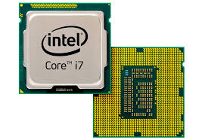
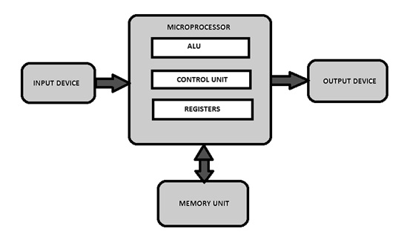
Microprocessors
Microprocessors are a type of computer processor which perform the function of a central processing unit (CPU) on one or multiple ICs.
This “brain” of the computer can carry out computations (like arithmetic and logic).
Since its primary purpose is to process data, it typically does not have memory or peripheral devices itself.

Slide 11
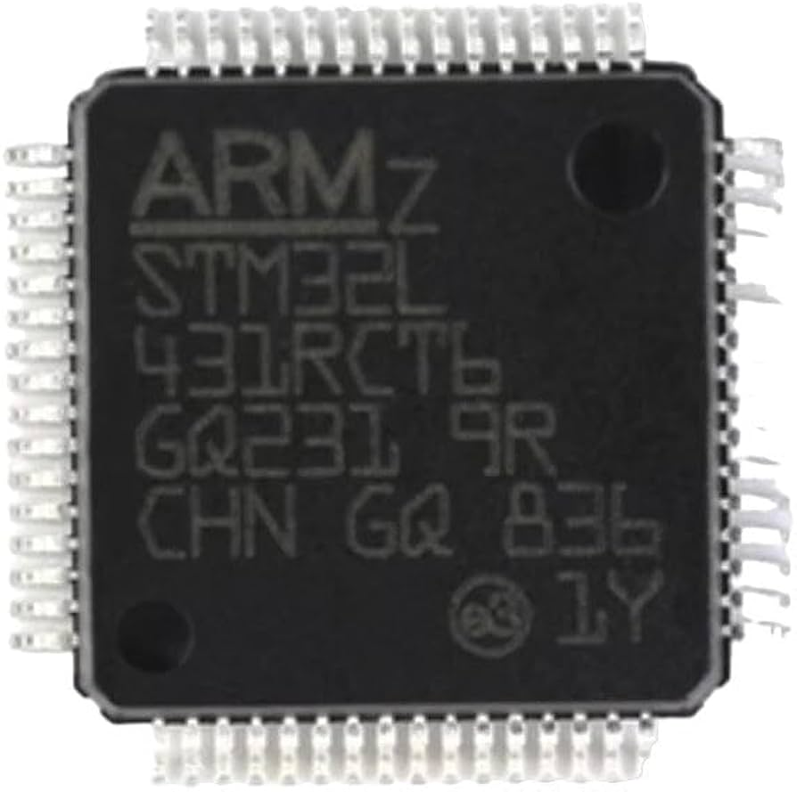
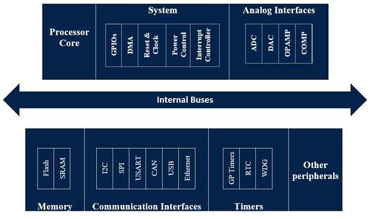
Microcontrollers (MCUs)
Unlike microprocessors, microcontrollers (MCUs) combine the functions of CPUs, memory, and peripheral interaction onto one chip (like a small computer).
Typically classified by bit size (8, 16, 32, or 64-bit)
Increasing this usually means faster and larger processing along with more addressable memory
These devices are programmable, and integrated development environments (IDE) make it easy to write, compile, and upload code.
We will be using a microcontroller from the popular STM32 series, specifically the STM32F401RET6U
Understanding STM32 Naming Conventions

Slide 12
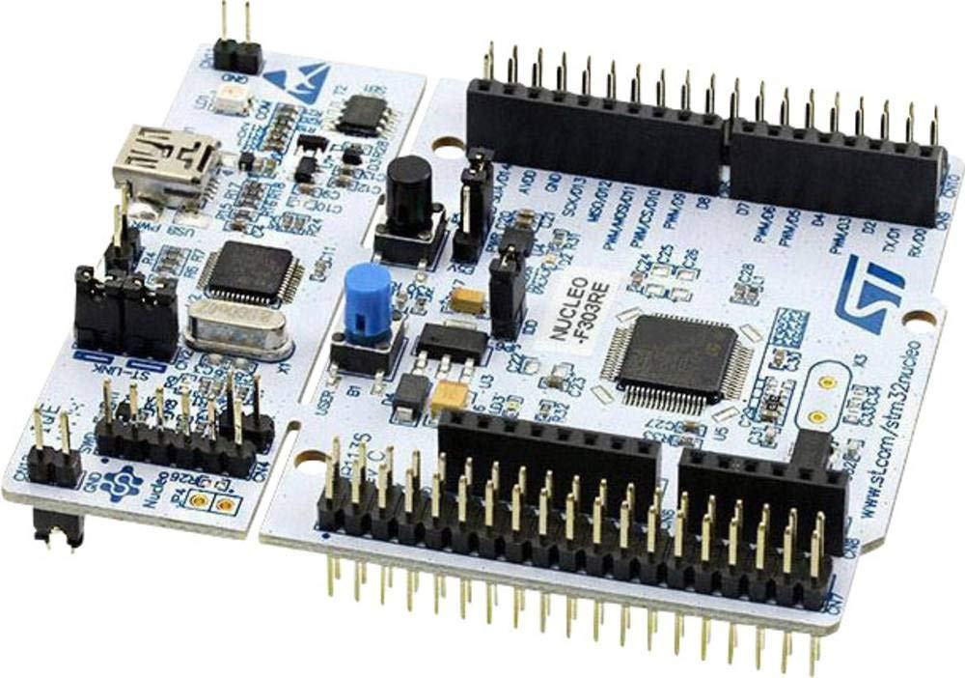

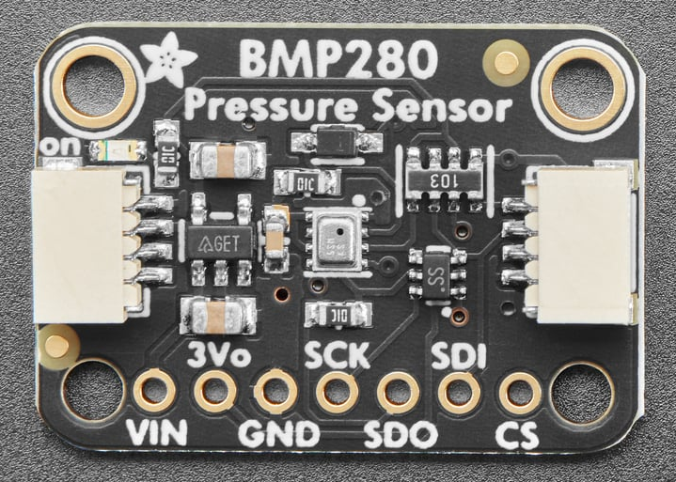
Development/Breakout Boards
Development (dev) boards are printed circuit boards (PCBs) with a microcontroller/microprocessor mounted along with other useful components and easy access to pins to develop and test other devices.
We will be using the NUCLEO-F401RE dev board.
Breakout boards (BOB) are simple PCBs that allow easy access to pins on a surface-mount device along with other useful components.
For the final project, we will use the BMP280 which can measure temperature and atmospheric pressure.
A sensor placed on BOB

Slide 13
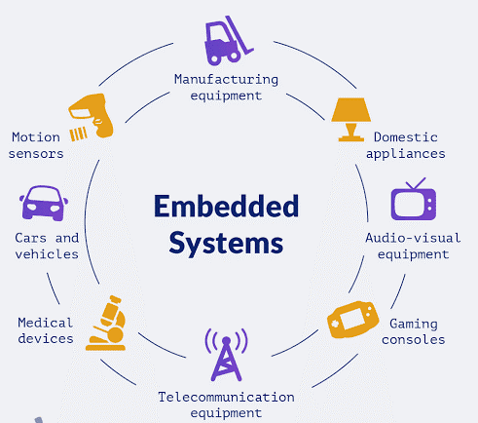
Embedded Systems
Embedded systems are specialized computer systems designed for specific functions.
They can be made of the previous devices and are integrated into a larger system or are standalone.
Many types of embedded systems such as real-time, network, mobile, etc.
They are used in industries such as consumer electronics, automotive, healthcare, etc.
Notes:
Real-time: Delivers output promptly
Network: Wired/wireless networks
Mobile: Portable

Slide 14
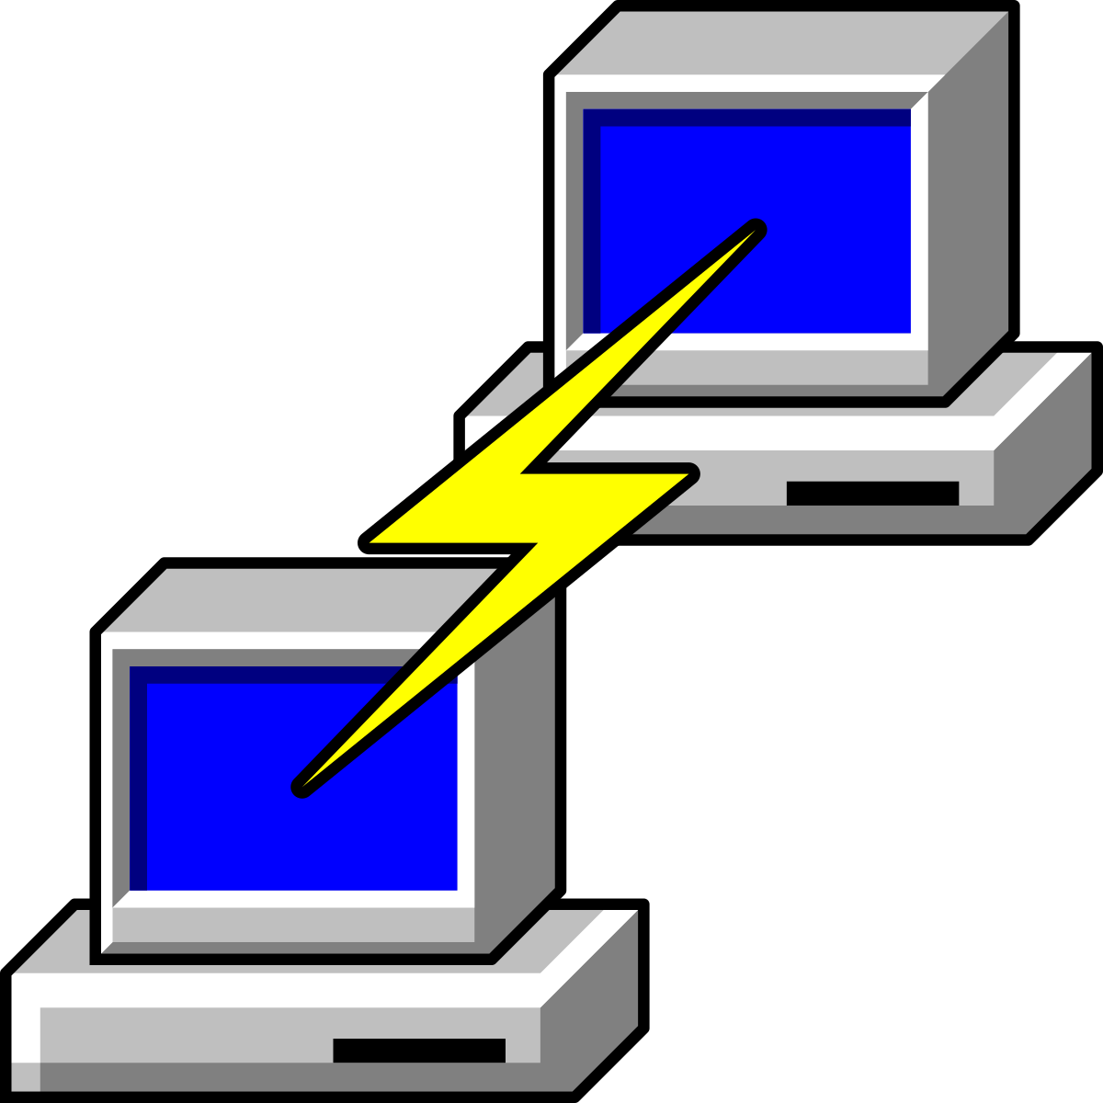
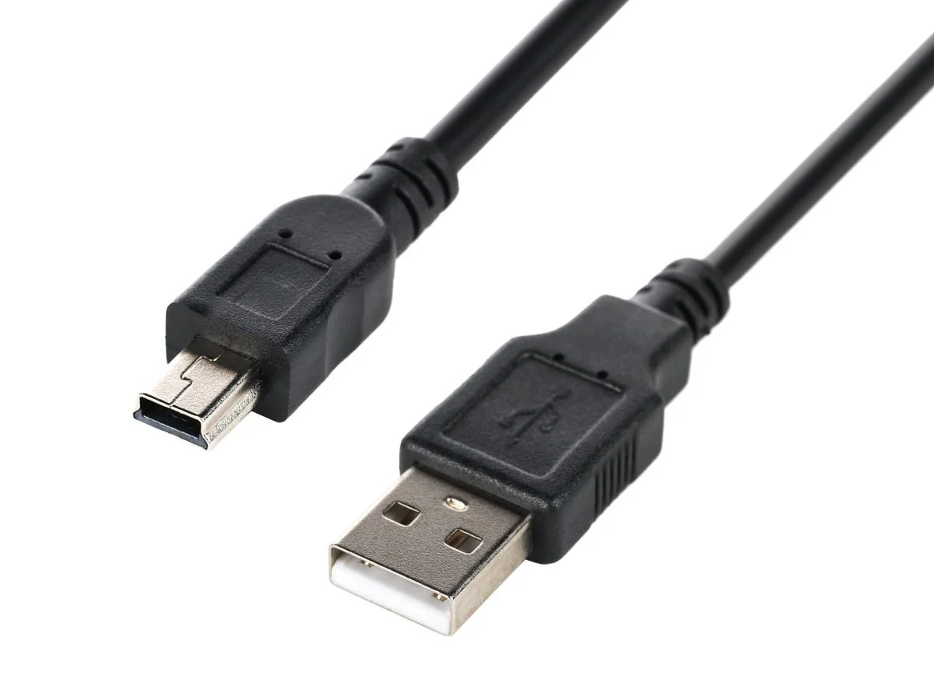
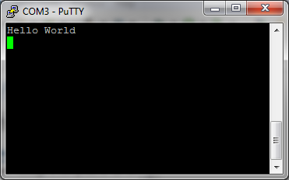
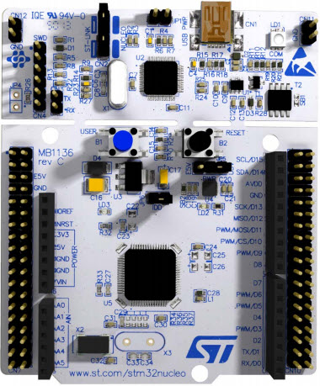
Demo: Blinky
What is needed?
Software:
STM32CubeIDE
PuTTY
Hardware:
NUCLEO-F401
USB-A to mini-B cable

Slide 15
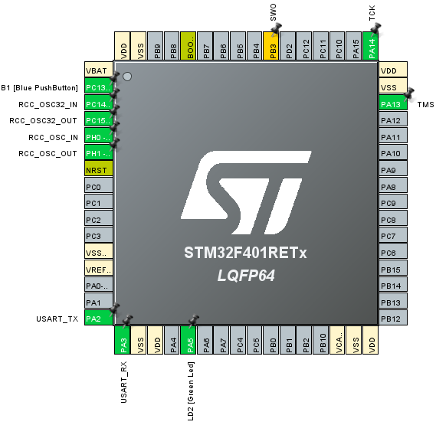
Demo: Blinky
Open STM32CubeIDE -> File -> New -> STM32 Project
Go to board selector, type “NUCLEO-F401RE” into commercial part number, select, and next
Type project name -> Finish -> Yes to initialize peripherals

Slide 16
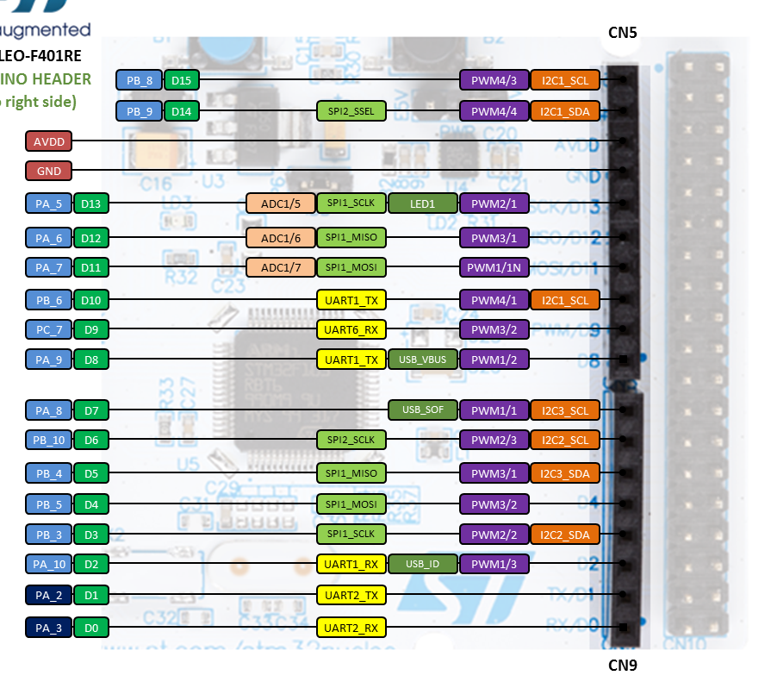
Demo: Blinky
Notes:
Traffic light lab:

Slide 17
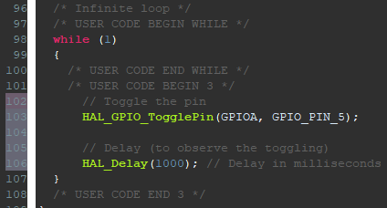
Demo: Blinky (cntd.)
Click drop-down by your project on the left tab -> Core -> Src -> Double-click main.c to open it
Scroll down to the first “while (1)” line
Copy the code on the right
Click the hammer to compile/build the code
Press the green start button to put the code onto the STM32
The green LED on the dev board should start blinking on and off in one-second intervals
// (Port A, Pin 5)
Notes:
HAL_GPIO_TogglePin(GPIOx, GPIO_Pin)

Slide 18
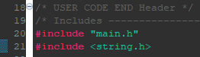
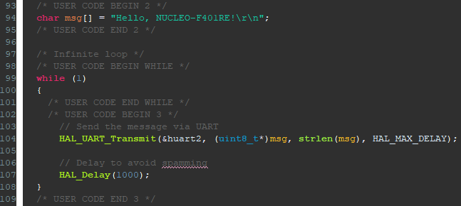
Demo: Terminal Print
In main.c, scroll to top and add “#include <string.h>”
Scroll to the while(1) (aka loop function)
Declare a variable named msg that has the datatype of a character and says the following message on line 94
**Note: Codes must be typed in between the
“CODE BEGIN” and “CODE END” comments
Build the project
Compile and run the code.

Slide 19
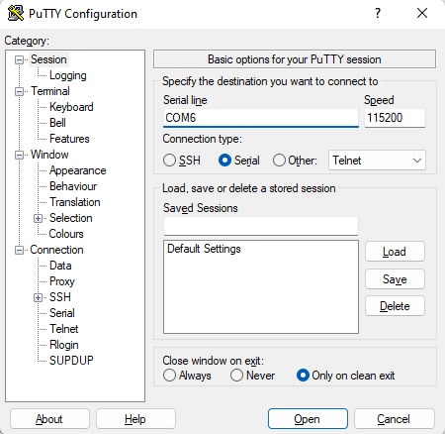
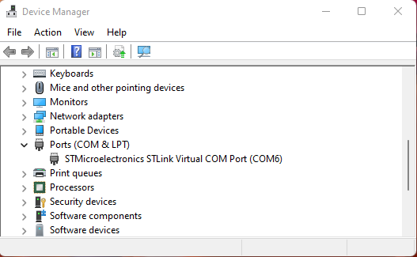
Demo: Terminal Print (cntd.)
Open device manager, go to ports section, and note what COM # the dev board is connected to.
Open PuTTY, select serial for connect type, set serial line to that in device manager, set speed to 115200 (baud rate).

Slide 20
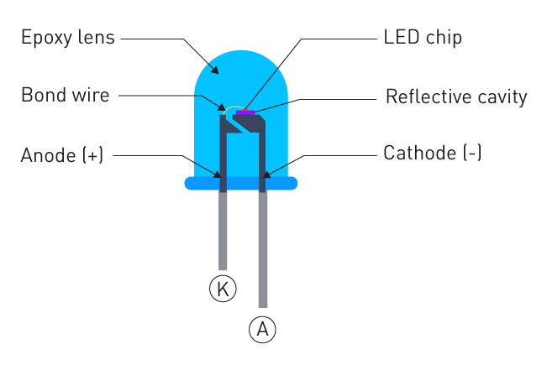
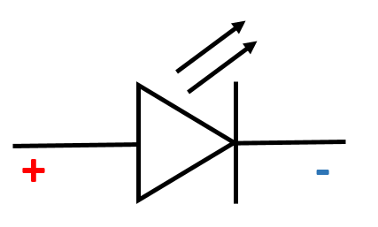
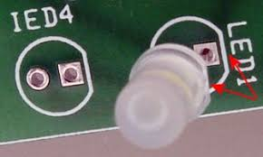
Supplemental Demo: Traffic Light
Light Emitting Diode (LED)
Polarity markers: (-) usually indicated by
Shorter pin
Flat spot
Anvil
LEDs cause a voltage drop, and the voltage at which they start conducting (getting brighter) is sometimes referred to as “Forward Voltage”.
(Post)
(Anvil)

Slide 21
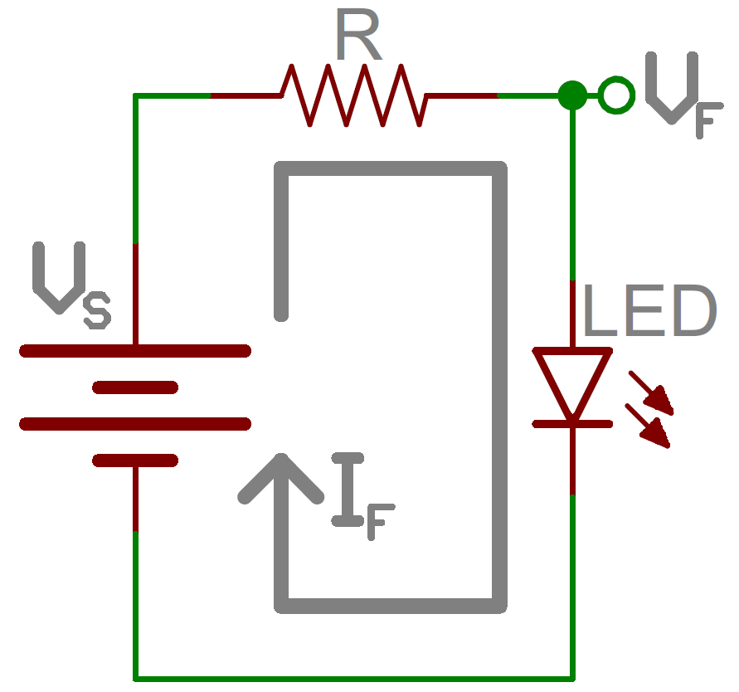
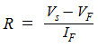
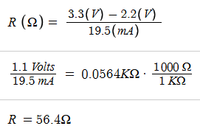
Supplemental Demo: Traffic Light
We use resistors in series with the LEDs to limit current flow. (25mA max per GPIO pin)
Example: Using Ohm’s Law for correct resistor
(Supply Voltage - Voltage Drop) / target current = Ideal resistance
An STM32 i/o pin supplies 3.3V. Assume there is no current regulator. The forward voltage of a red LED is 2.2V. Assume the red LED draws 19.5mA at 2.2V. How much resistance should be in series with the LED to reduce the current draw to 19.5mA?

Slide 22
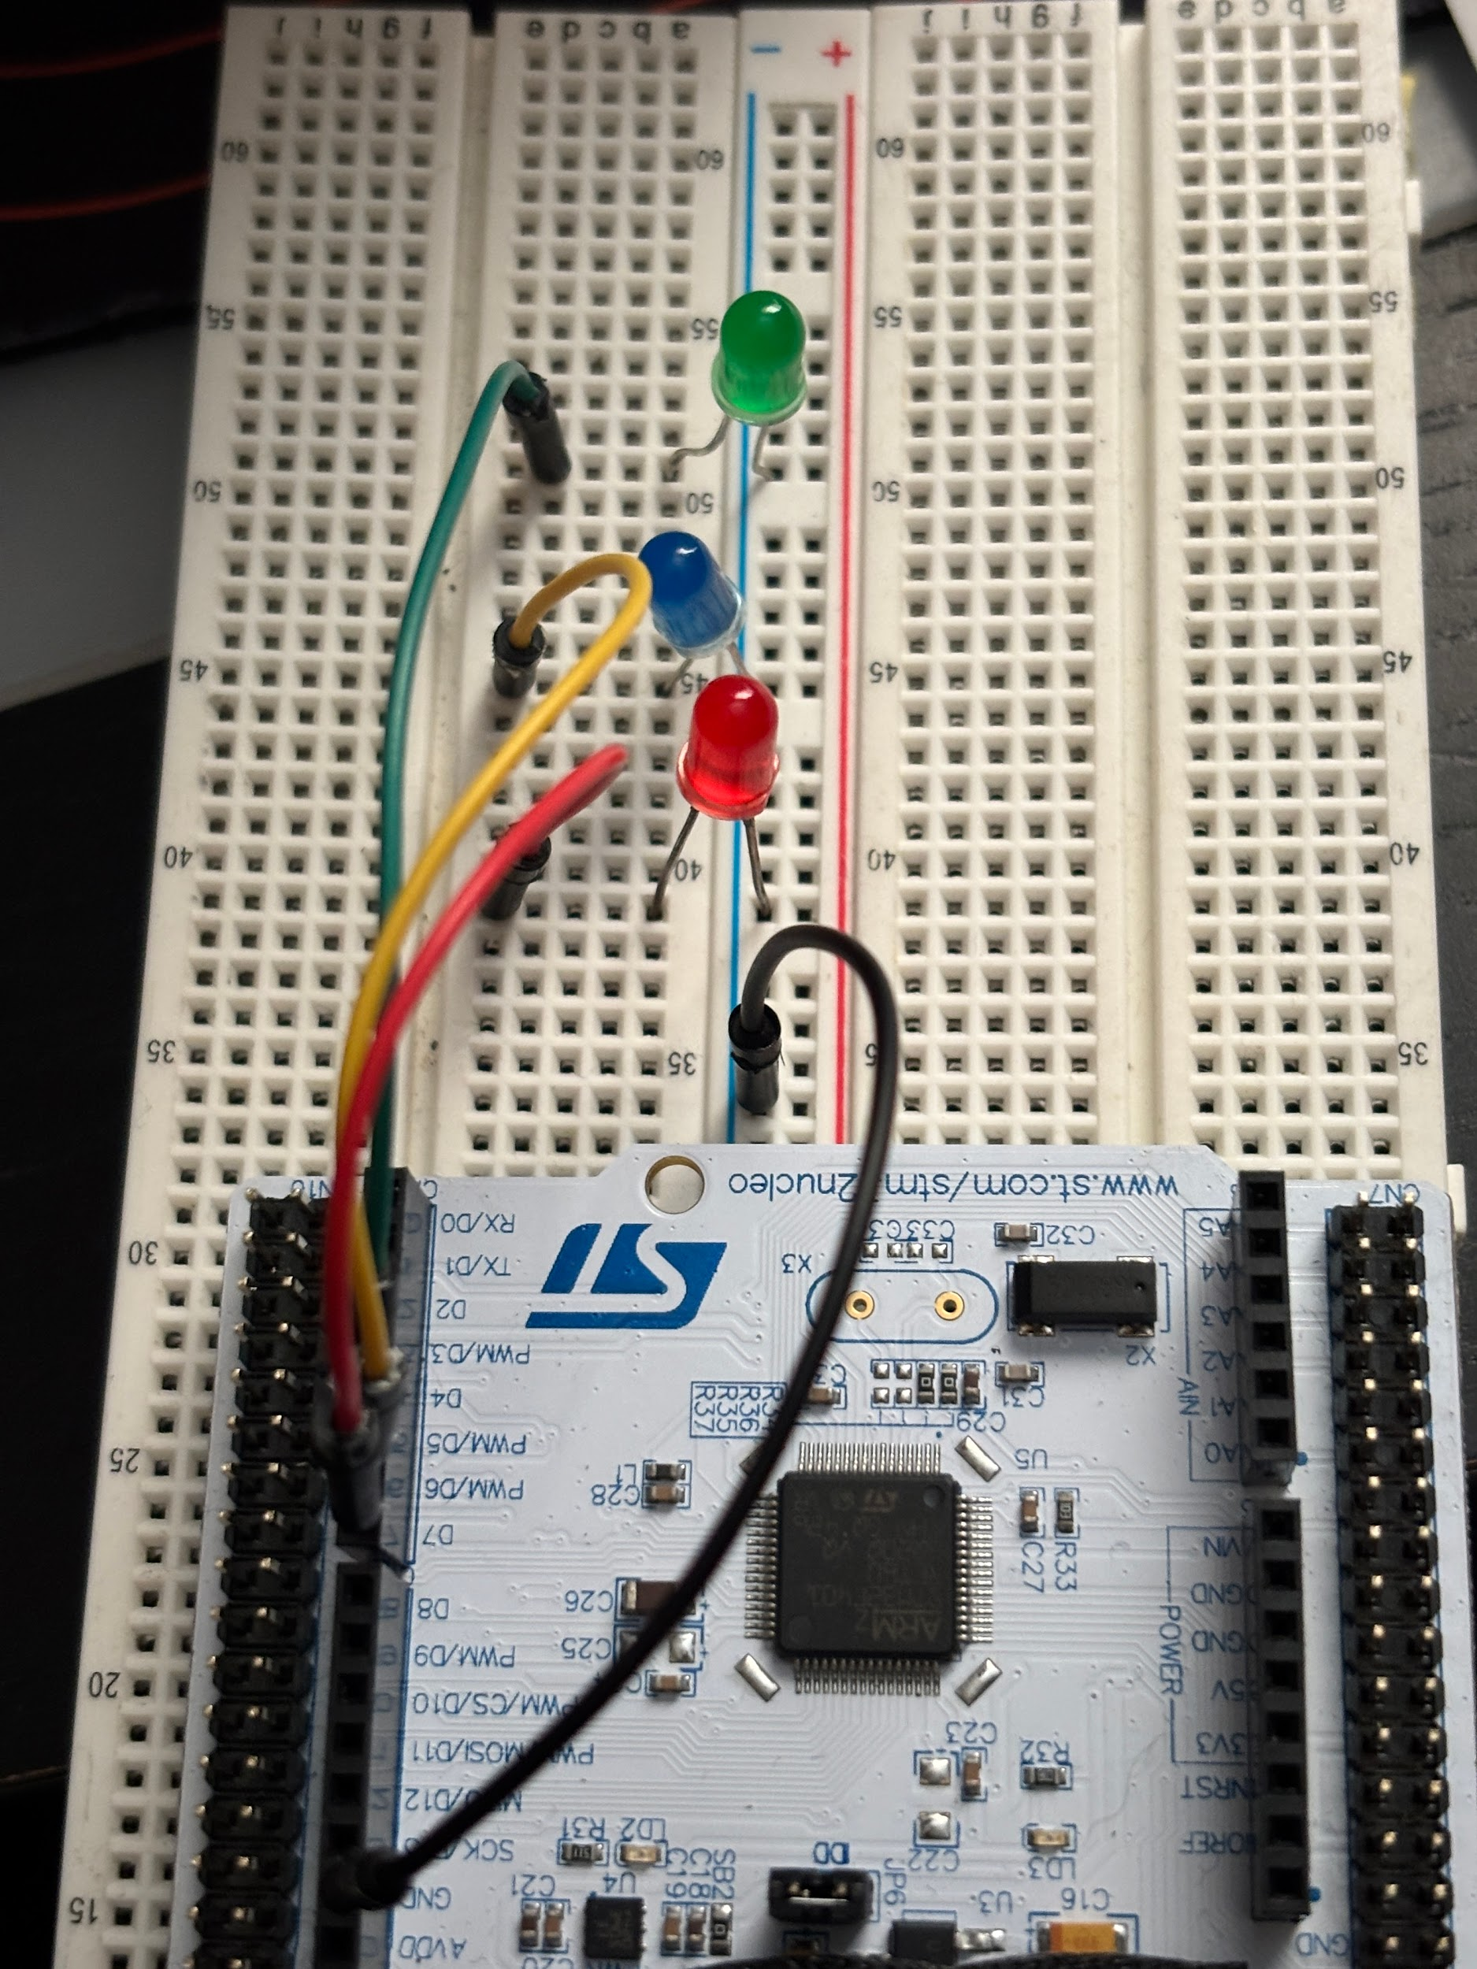
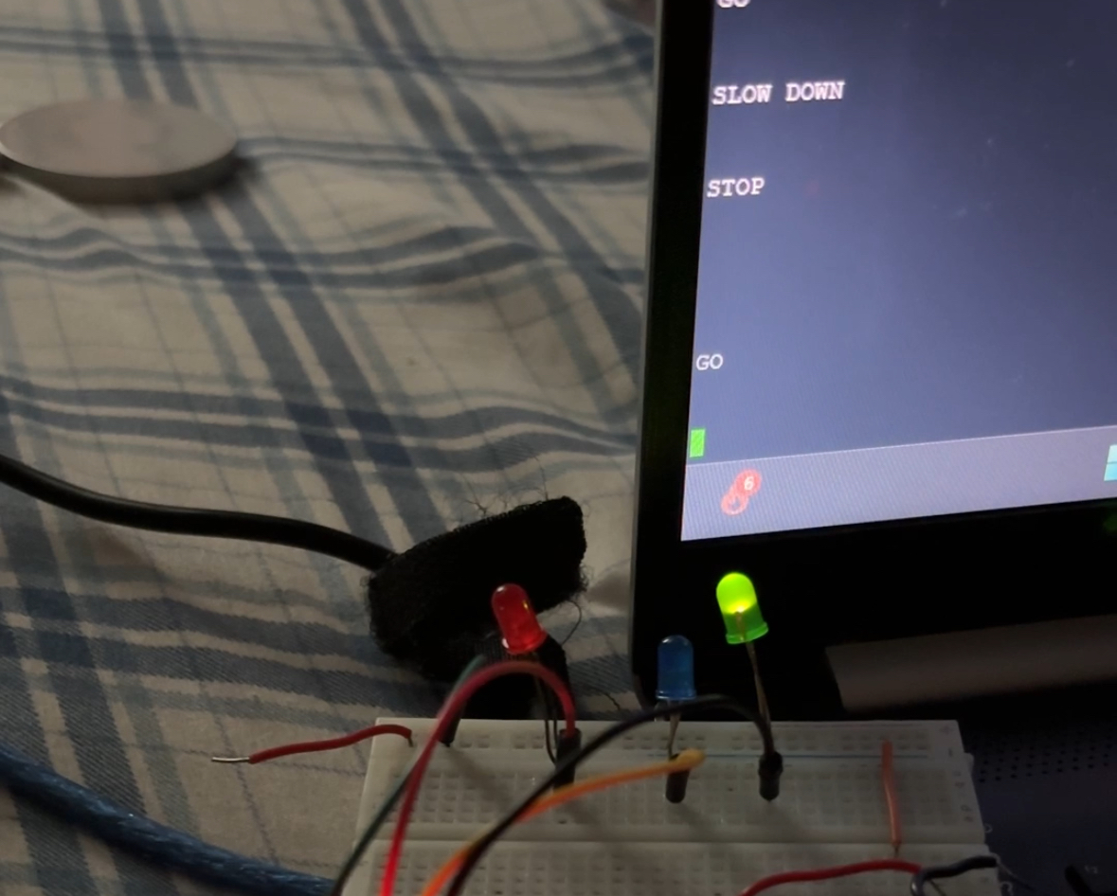
Supplemental Demo: Traffic Light
What is needed?
Software:
STM32CubeIDE
PuTTY
Hardware:
NUCLEO-F401
3x LED, 3 different colors preferred
4x Male-Male Jumper Cables
2x 100Ω

Slide 23
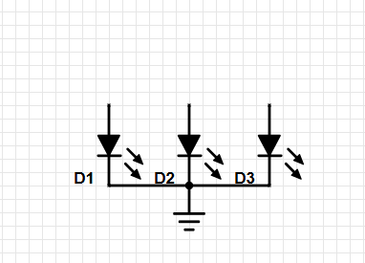
Supplemental Demo: Traffic Light
Build the circuit from this schematic:
Jump the GND pin (STM32) to a power rail on the breadboard.
Programming hints:
Which ports and which pins are being used for D 5-7 ? (slide 15).
Create three new variables for each one displaying “GO”, “SLOW”, and “STOP”.
Copy and paste the HAL_Transmit function from your hello command. Which parameters do you change?
D7
D6
D5

Slide 24
Join us next meeting for STM32 Design Requirements!
Nothing new is needed for next week. Any Questions?

